Slide 1
My Process for Creating a Learning Module

Slide 2


The goal for this project was to update the course content from the in-person class to a user-friendly online course environment for the program.
The approach to designing these modules was using a backward design
approach.

Slide 3
COURSE MAP
Learning Outcomes | Assessment Methods | Learning/Practice Activities | Content Delivery/Exploration Methods
Compare online learning to on-ground learning | Discussion Rubric | Introductions/ Watching a video and responding to the topic and classmates | Discussion Forum
Identify the knowledge, skills, and behaviors of successful online learners and assess your own readiness for online learning. | Different types of assessment questionnaires | Complete the assessment to determine level of knowledge, style of learning,
 | Reflection | Journaling | Private journal entries between the student and instructor
 | Q/A section for students | Created a virtual office. Allows for students to ask general questions to the instructor on the course and/or its content. | Discussion Forum
 | Multimedia presentations | Short video presentations from the web | Short You Tube videos

Slide 4
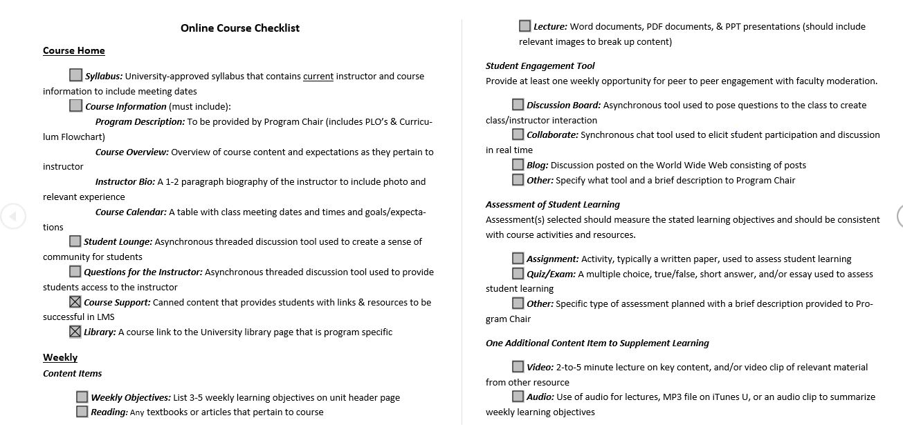
COURSE CHECKLIST

Slide 5
Design Choice

Slide 6
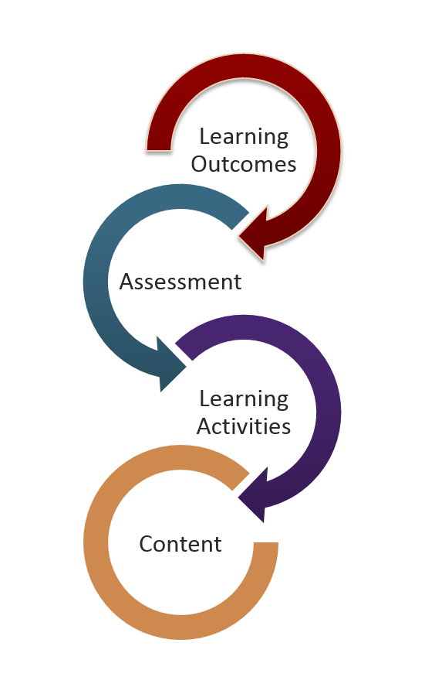
BACKWARD DESIGN
Introduction to Online Learning

Slide 7
BACKWARD DESIGN
Identify desired results. What should students know and be
able to do at the end of the course?
Determine acceptable evidence that students have achieved
these learning outcomes.
Plan learning experiences, instruction, and resources that will help students be able to provide evidence that they have met the learning outcomes.

Slide 8
BACKWARD DESIGN
This type process provides consistency for students and
supports more accurate construction of course concepts
It is about beginning with the end in mind. Starting
with desired learning outcomes, clearly stated in measurable terms, and working backwards through assessment activities, teaching and learning activities, and content delivery.

Slide 9

References
Barrett, S., Poe, C., & Spagnola-Doyle, C. (n.d.). Power Up: A Practical Student's Guide to Online Learning (2nd ed.). New York: Pearson.
“eLearning Fun Facts” https://www.panopto.com/blog/infographic-20-facts-about-elearning/
Backward Design https://canvas.ucdavis.edu/courses/34528/pages/course-planning-with-backward-design?module_item_id=4965
http://www.ion.uillinois.edu/
Savvy Student's Guide to Online Learning

